Slide 1
Stock Market Prediction
Anurag Gujarathi
3134

Slide 2
Literature Survey
‘’Global Nonlinear Kernel Prediction for Large Data Set With a Particle Swarm-Optimized Interval Support Vector Regression” – IEEE transactions on Neural networks and Learning Systems, October 2015
‘’Which artificial intelligence algorithm better
predicts the Chinese stock market?’’ – IEEE Access

Slide 3
Motivation
Volatile nature of stock market.
Correct decision can make an investor a billionaire.
Wrong decision can make an investor bankrupt.
Success depends on the future worth of purchased stocks and fundamentals of the firm.
Notion for profitability –
Buy low
Sell high

Slide 4
Motivation
A prediction model can assist investors in making informed and intelligent decisions.
Intelligent decisions can potentially earn high return on investments for investors.
Thus a stock prediction model has been proposed for forecasting prices on the basis of historical data.

Slide 5
Problem Statement
Prediction of Stock Market using historical data.
Abstract-
A stock market is the aggregation of buyers and sellers which represent ownership claims on businesses. Intelligent investments in the stock market can potentially earn high returns to investors. However, due to the non-linear nature of stock market fluctuations, it is difficult to make an intelligent decision. This leads to the need of a model, which can predict the stock market on the basis of historical data. Concepts like Regression, Artificial Neural Networks and Support Vector Machines make it possible to predict values on the basis of historical data. A model for estimating the daily opening and closing prices of the stock market has been proposed.

Slide 6
Regression Analysis
In statistical modeling, regression analysis is a set of statistical processes for estimating the relationships among variables. It includes many techniques for modeling and analyzing several variables, when the focus is on the relationship between a dependent variable and one or more independent variables (or 'predictors'). source : https://en.wikipedia.org/wiki/Regression_analysis

Slide 7
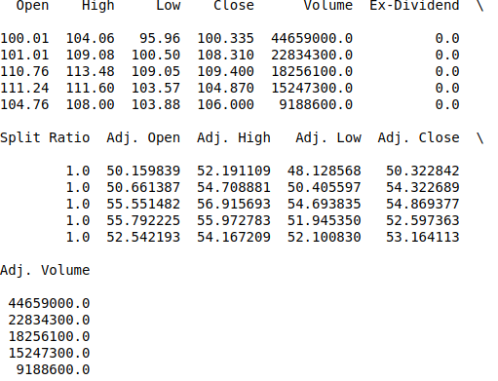
Features
Dataset – Quandl GOOGL

Slide 8
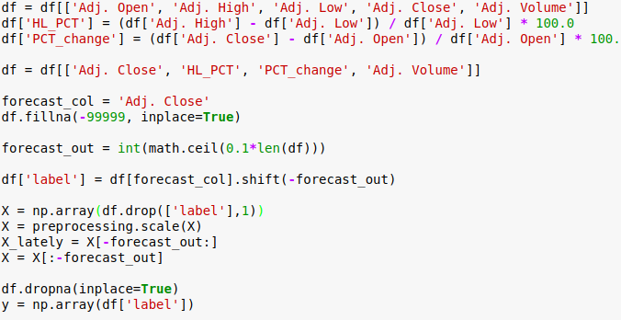
Adjusting Features

Slide 9
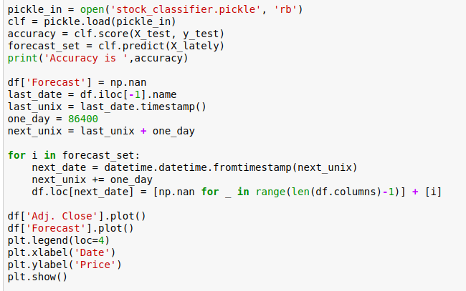
Algorithm Logic

Slide 10
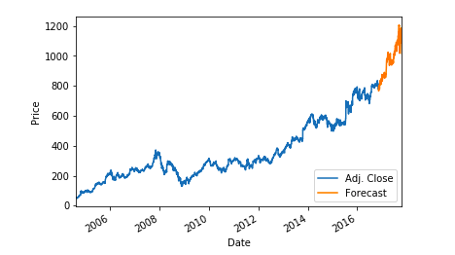
Result

Slide 11
Support Vector Machine
In machine learning, support-vector machines (SVMs, also support-vector networks) are supervised learning models with associated learning algorithms that analyze data used for classification and regression analysis. Given a set of training examples, each marked as belonging to one or the other of two categories, an SVM training algorithm builds a model that assigns new examples to one category or the other, making it a non-probabilistic binary linear classifier.
Source- https://en.wikipedia.org/wiki/Support-vector_machine

Slide 12
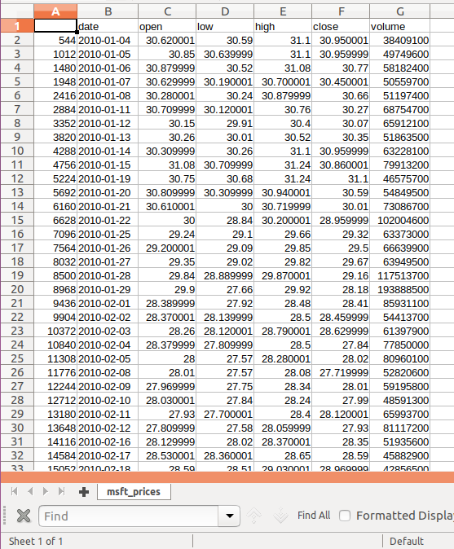
Dataset

Slide 13
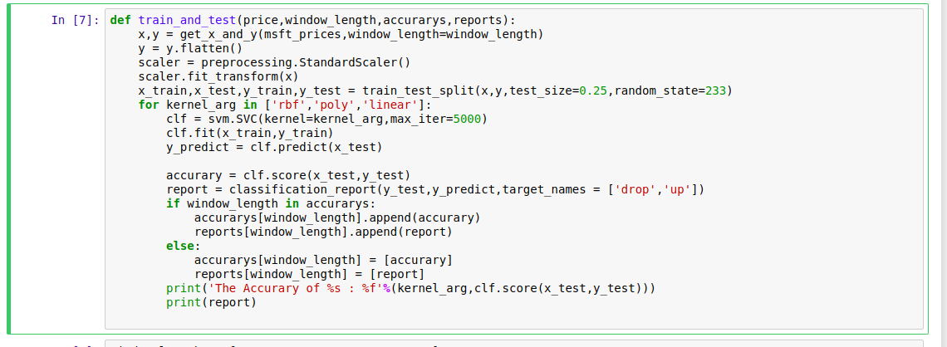
Algorithm Logic

Slide 14
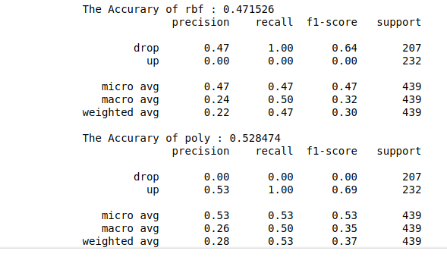
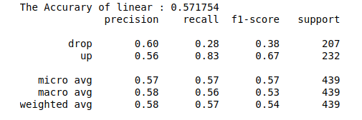
Result

Slide 15
Particle Swarm Optimization
In computational science, Particle Swarm Optimization (PSO) is a method that optimizes the problem by iteratively trying to improve a candidate solution with regard to a given measure of quality.
It solves a problem by having a population of candidate solutions, here called particles, and moving these particles around in the search space over the particle’s position and velocity.
Source: https://en.wikipedia.org/wiki/Particle_swarm_optimization

Slide 16
Conclusion
Using polynomial regression and support vector regression, accuracy of prediction model varies between 50% and 70% for the dataset used.
The accuracy is dependent on training data.
Although stock prices can be predicted to a certain extent using only historic data, other factors also influence stock prices.

Slide 17
Conclusion
Following factors also affect stock prices -
Economics
Interest rates
Inflation
Politics
Government policy
Elections
Natural and Man-made disasters
Japan in 2011 tsunami
World War II
Market Psychology
Hype created by economists

Slide 18
Conclusion
Therefore, a prediction model must take into account all factors which may affect the stock market.

